Slide 1
ELEMENTARY School RANKING PREDICTIVE ANALYSIS DATA SCIENCE PROJECT

Slide 2


CONTENTS
BUSINESS CASE
DATA ACQUISITION
DATA PREPERATION
DATA VISUALIZATION
EXPLORATORY DATA ANALYSIS
HYPOTHESIS MODELING
EVALUATION
CONCLUSION
OPERATIONALIZATION

Slide 3
BUSINESS CASE
School Rank Analyzer provides ranking for middle schools in all 50 states
Objective of this study is to provide a predictive model to establish ranking based on available parameters

Slide 4
DATA ACQUISITION
Current dataset is for Middle School
Data was obtained from data server in csv format

Slide 5
DATA PREPARATION
There are a total of 4308 records
No Duplicate values found in the dataset.
Number Fulltime Teachers & teacher student ratio missing for 17 schools
Percent of Students by Race data is missing for 1 schools
Average Standard Score 2015-16 missing for 8 schools
In total, 312 (7%) records were ignored for this analysis.
After cleaning the records, 96.4% of original data is retained for data analysis.

Slide 6
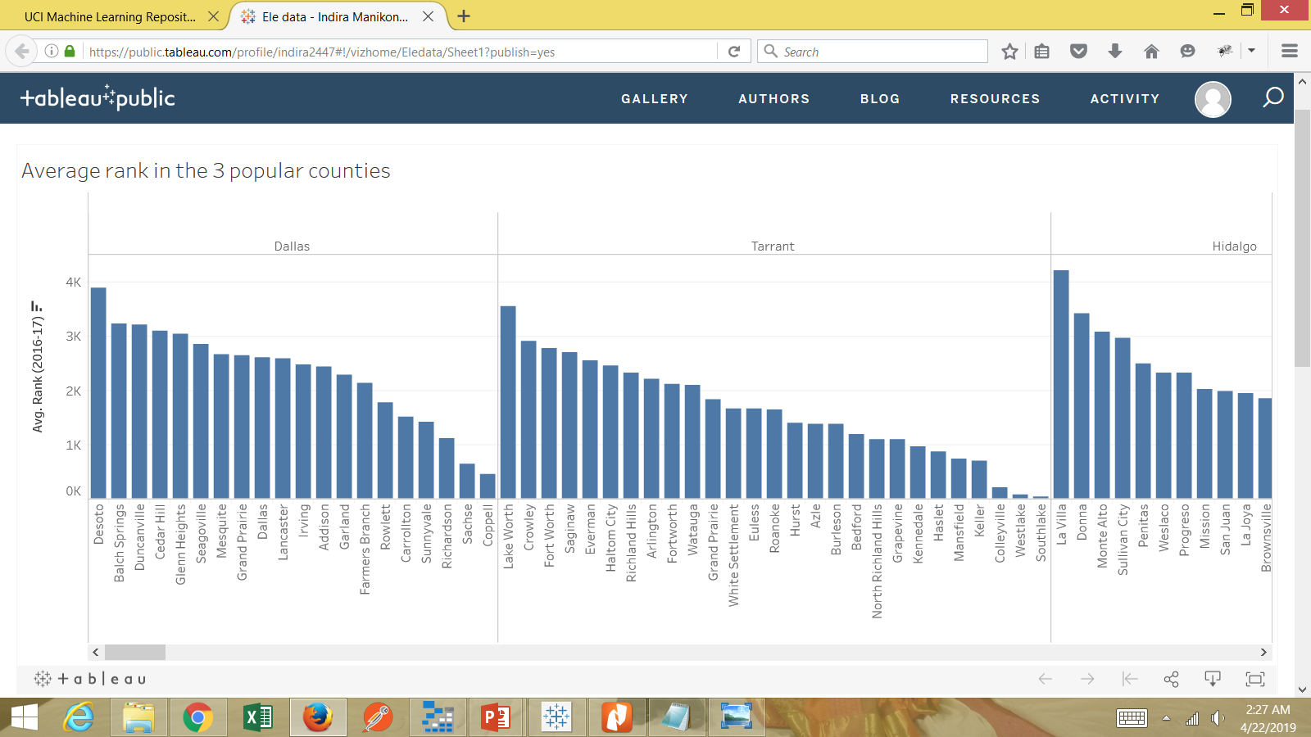
DATA VISUALIZATION
Average rank in 3 popular counties

Slide 7
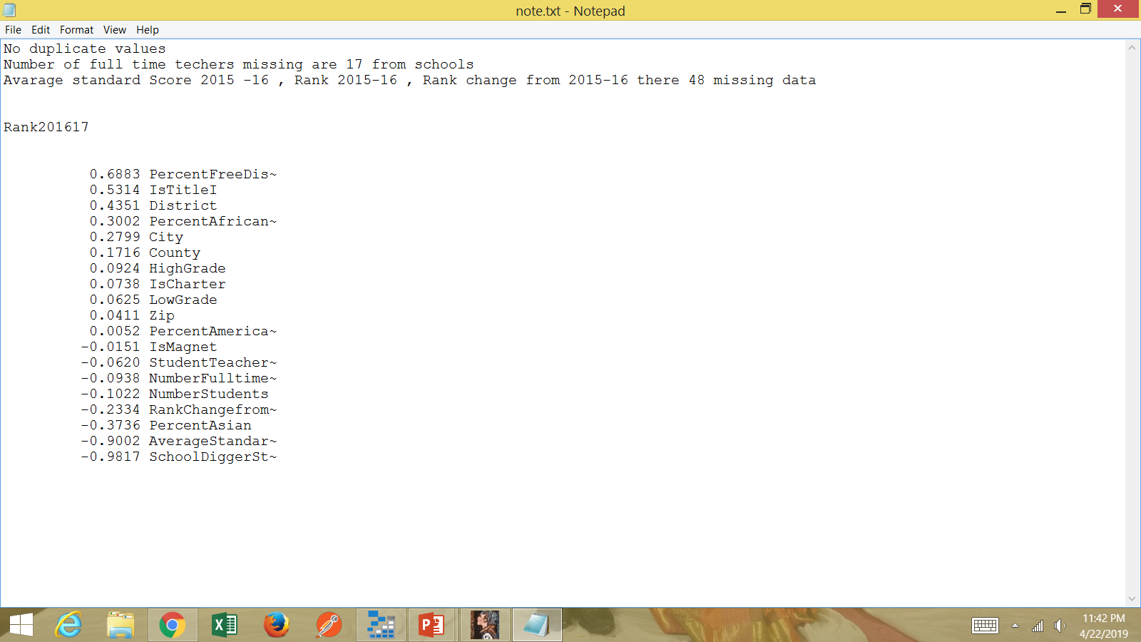
Exploratory data analysis correlation matrix
Rank seems to be geting worse in schools when they offer more free lunch "p value is 1.75e-010>0.05 so rank(xi) is not impacting percent of free lunch (y)".
IsTitleI is moderately influencing factor for rank201617, and it is negatively impacting rank. p value of Istitle is 1.64e-09>0.05 so rank (xi) is not impacting Istitle (y) and due to r=.53 so Istitle is most likely impacting rank.
District is most likely impacting on Ranking and it is negatively influencing due to p value of District is 0.1140>0.05 so rank is not impacting on district.
Percent African is having weak likelihood that the ranking might be negatively impacting with more people African population in school. Due to p=6.37e-033>0.05 so rank is not influencing percent african.
City is having weak negatively impacting on rankings. Due to p=6.37e-033>0.05 rank is not influencing city but rank is weakly correlated to city

Slide 8




Exploratory data analysis
TOP 5 INFLUENCERS
PERCENT FREE DISCOUNT LUNCH
IS TITLE 1
DISTRICT
PERCENT OF AFRICAN AMERICAN
CITY

Slide 9
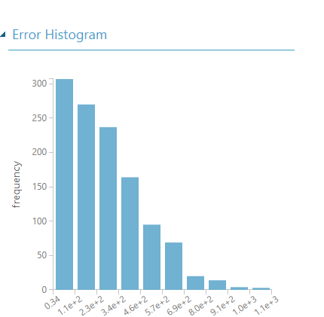
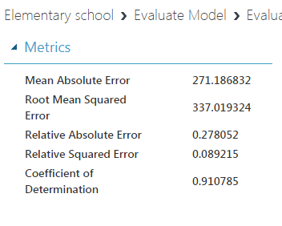
Predictive Analysis
A Linear Regression model Predicted most of the Rank201516.
District , Average standard score2015-16, Percent Free/Disc Lunch identified as top 3 features in a dataset with the greatest predicting power.
Metrics are quite good , and the model is satisfactory .

Slide 10
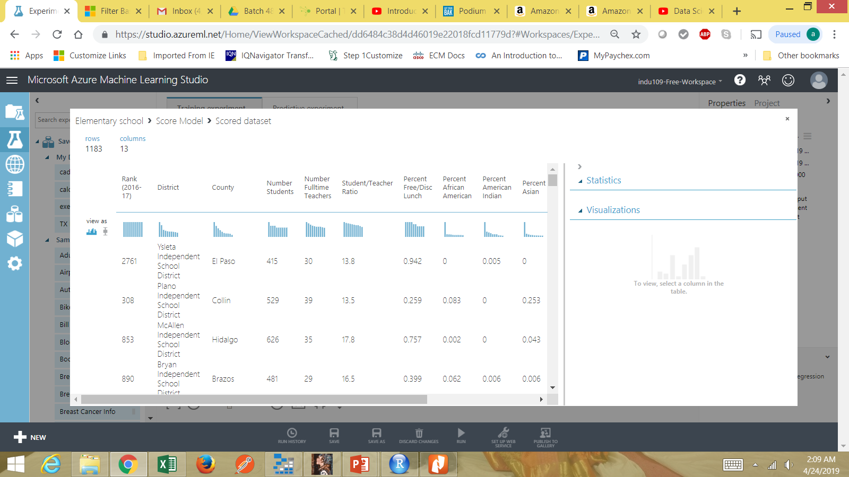
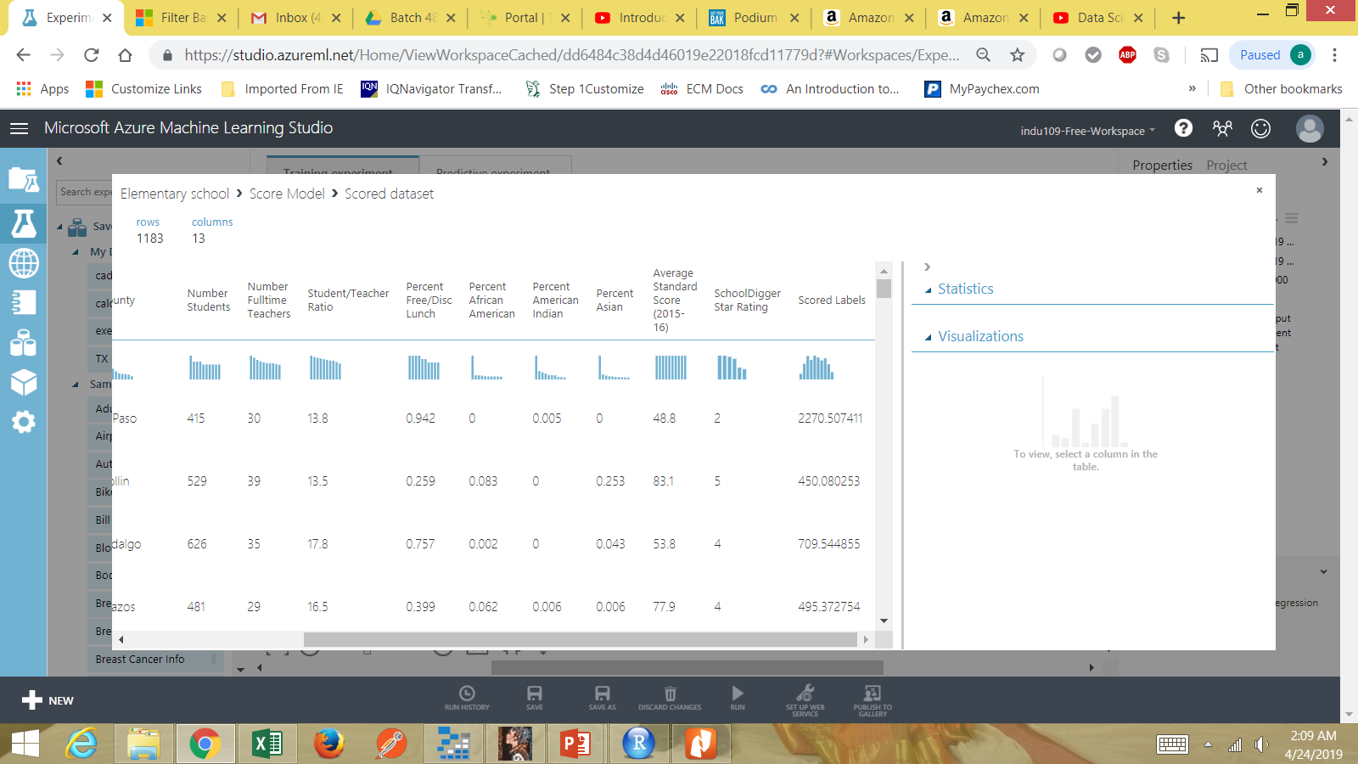
Score Model
Values of rank and after testing the score model display the values.

